Slide 1
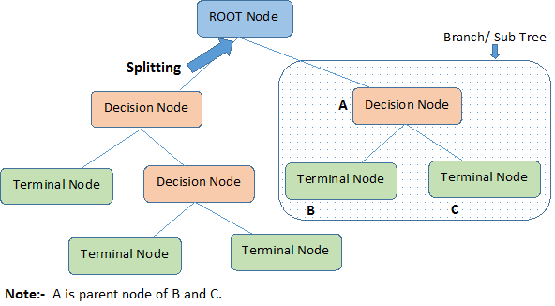
Decision Tree Regression(CHAID)
KARTHIK S

Slide 2
INDEX
What is Decision Tree Regression
What is Chi-Squre
What is CHAID
Parameters and Hyper-parameters
Applications
Reference

Slide 3
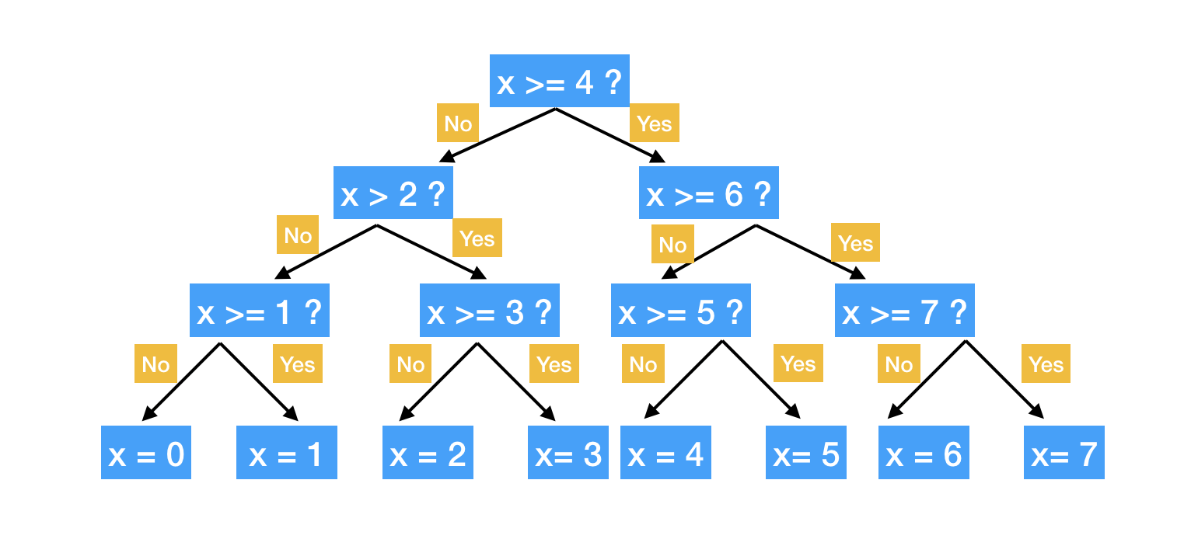
What is Decision Tree regression
Decision tree regression is a type of regression analysis in machine learning that uses a decision tree as a predictive model
The internal nodes of the tree represent features or attributes of the data, and the leaf nodes represent the output or target variable

Slide 4

What is chi-squre
The chi-square (χ²) test is a statistical test used in hypothesis testing to determine if there is a significant association between two categorical variables.
The test calculates the difference between the observed and expected frequencies in a contingency table and returns a chi-square statistic.

Slide 5
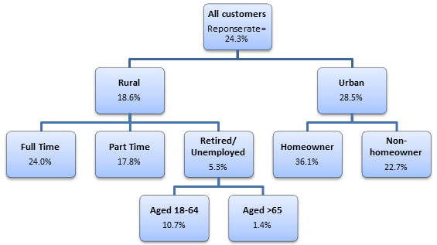
What is CHAID
The CHAID (Chi-squared Automatic Interaction Detector) algorithm is a statistical method used to build decision trees for regression problems.
The CHAID algorithm uses a chi-squared test to determine which variables interact with one another and to split the data into homogeneous groups

Slide 6
Implementing a decision tree regression using CHAID:
Prepare the data: Clean and preprocess the data to get it ready for modeling.
Calculate the chi-squared test statistic: The chi-squared test is used to determine the dependence between the predictor and target variables.
Determine the splitting variable: Select the predictor variable that gives the highest chi-squared test statistic.

Slide 7
Implementing a decision tree regression using CHAID:
Split the data: Split the data into subsets based on the splitting variable.
Repeat the process: Repeat the process of calculating the chi-squared test statistic, determining the splitting variable, and splitting the data until the stopping criteria are met (e.g., the minimum number of samples in a leaf node, maximum depth of the tree, etc.).
Make predictions: Use the decision tree to make predictions on new data.
Evaluate the model: Evaluate the performance of the model using metrics like mean squared error or R-squared.

Slide 8
Parameters and Hyper-parameters
Significance level: The significance level is a probability threshold that determines the likelihood of a false positive or type I error. The default value is 0.05.
Maximum tree depth: The maximum tree depth determines the maximum number of splits that can be made in the tree. This parameter is used to control overfitting.
Minimum cases per node: The minimum number of cases required to split a node. This parameter is used to control overfitting.

Slide 9
Parameters and Hyper-parameters
Maximum number of branches: The maximum number of branches that can be created at a node. This parameter is used to control overfitting.
Method of splitting: CHAID provides options for splitting the tree, such as chi-square automatic interaction detection (CHAID) and chi-square multivariate interaction detection (CHiM).
Target variable: The target variable or response variable is the variable to be predicted by the decision tree.

Slide 10
Parameters and Hyper-parameters
Minimum improvement: The minimum improvement in the chi-square statistic required to split a node. This parameter is used to control overfitting
These hyper-parameters can be adjusted to improve the performance of the model or to control overfitting. The optimal hyper-parameter values can be determined through cross-validation or grid search methods.

Slide 11
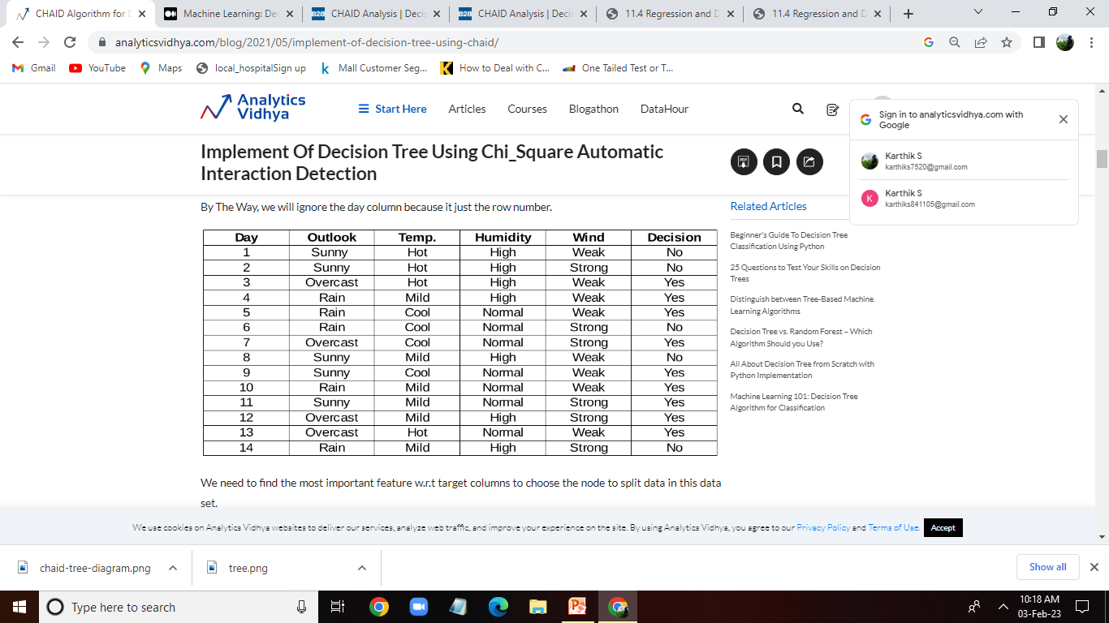
Example

Slide 12
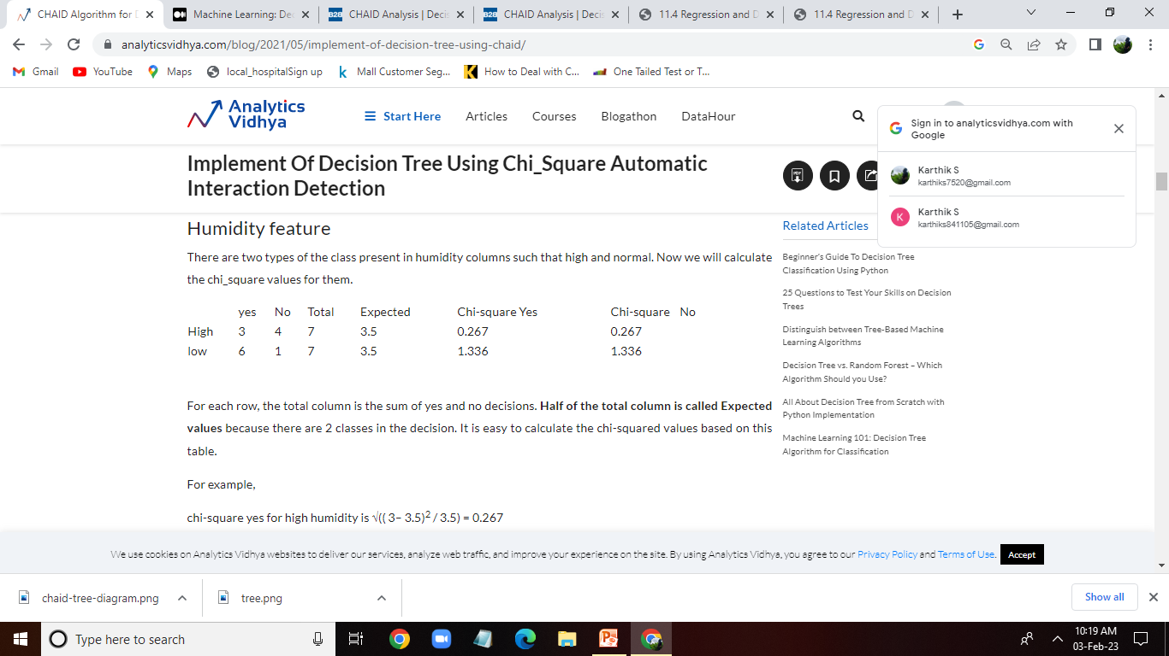

√((y – y’)² / y’)

Slide 13
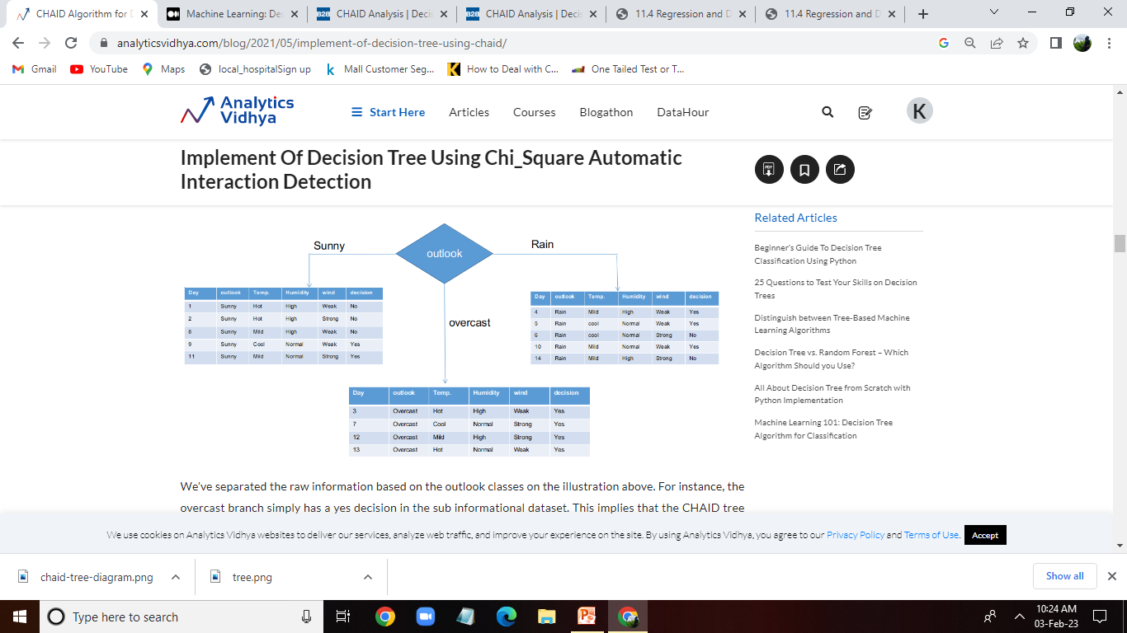
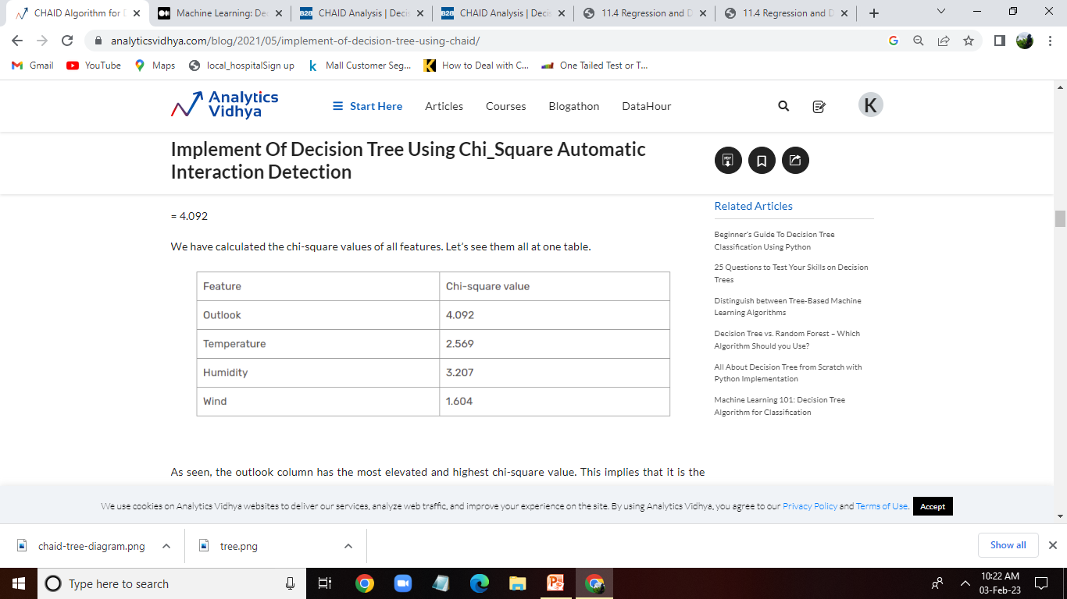

Slide 14
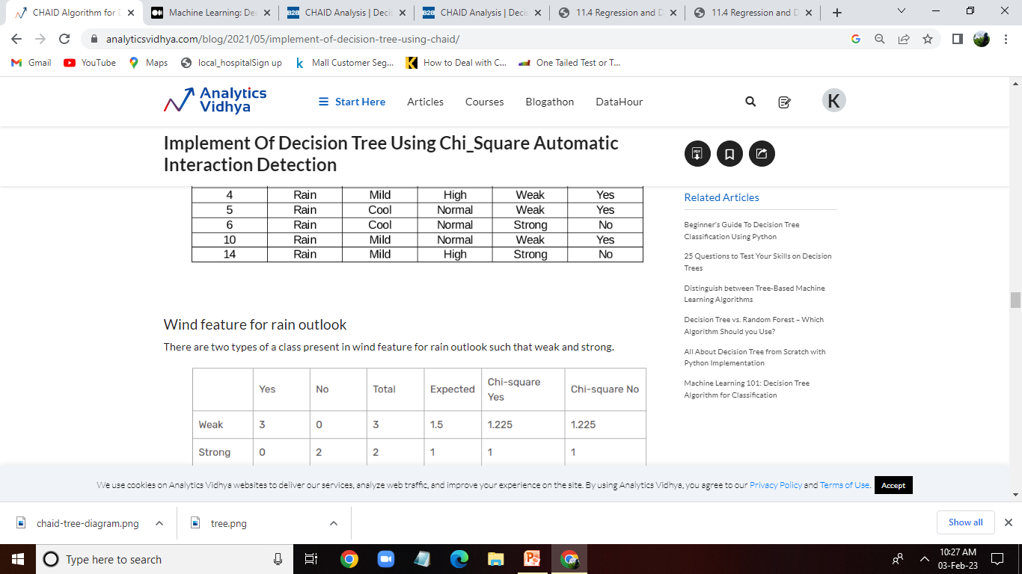


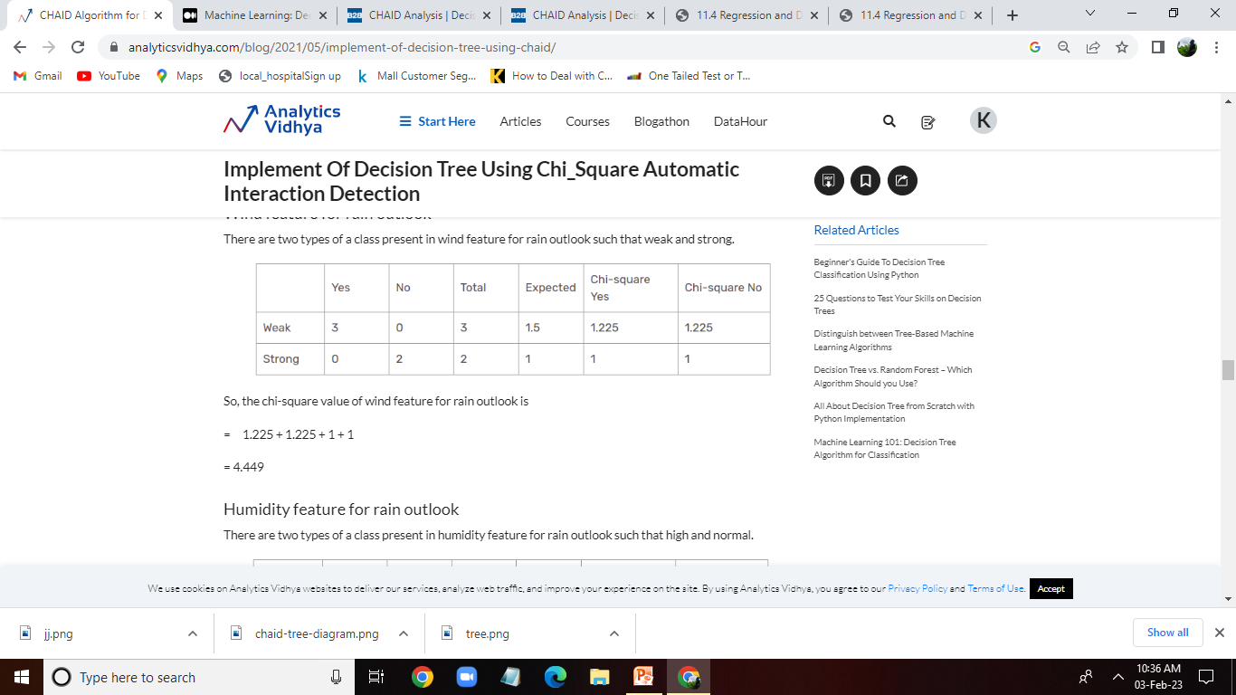

Slide 15
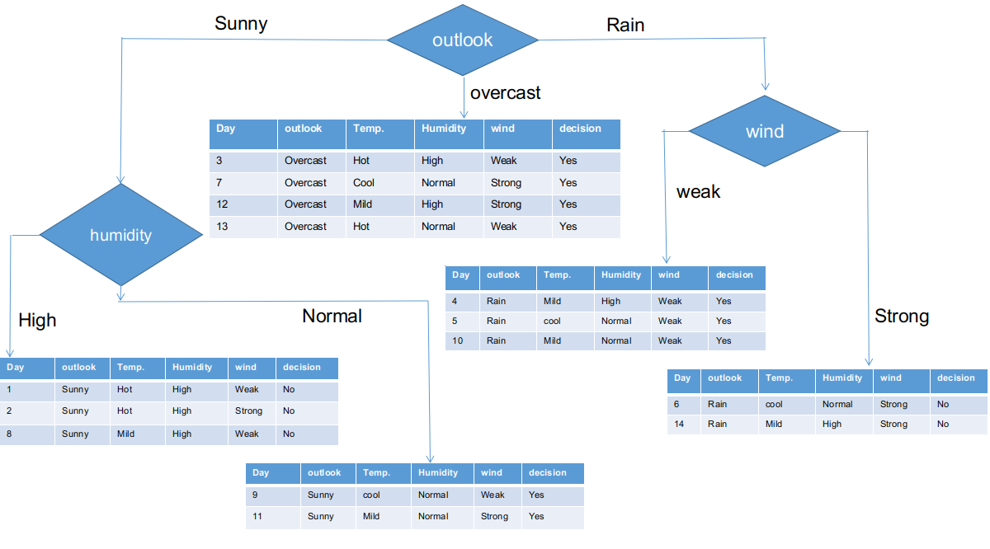
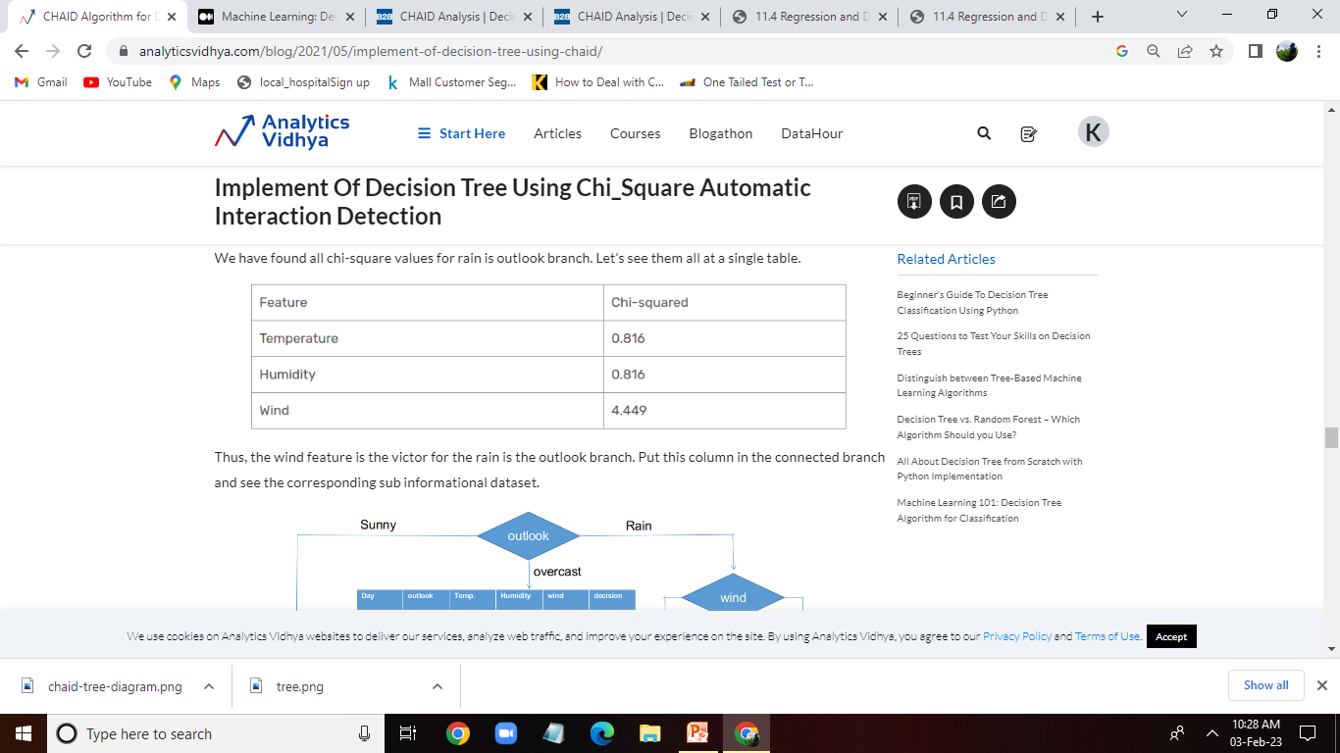

Slide 16
Advantage
Interpretability: CHAID trees provide a visual representation of the relationships between predictor variables and the target variable, which makes them easy to understand and interpret.
Handling Interactions: CHAID can handle interactions between predictor variables, which can be important in many applications
Flexibility
Computational Efficiency

Slide 17
Disadvantage
Overfitting: CHAID trees can easily overfit the data, resulting in a tree that is too complex and does not generalize well to new data
Bias: CHAID trees can be biased towards variables with a large number of categories, as they may dominate the splits in the tree.
Stopping Criteria

Slide 18
Application
Sales forecasting: CHAID is used to identify the key drivers of sales and predict future sales based on these drivers
Customer behavior analysis: CHAID can be used to analyze customer behavior and predict which customers are likely to purchase a particular product or service.
Credit Risk Analysis: CHAID can be used to analyze credit risk by identifying factors that influence the likelihood of loan default.
Insurance: CHAID can be used in insurance to analyze data on policyholders and predict which policyholders are most likely to file claims.

Slide 19
Reference
https://www.analyticsvidhya.com/blog/2021/05/implement-of-decision-tree-using-chaid/
https://towardsdatascience.com/clearly-explained-top-2-types-of-decision-trees-chaid-cart-8695e441e73e
https://en.wikipedia.org/wiki/Chi-square_automatic_interaction_detection
https://sefiks.com/2018/08/28/a-step-by-step-regression-decision-tree-example/

Slide 20
Thank You

